Slide 1



The Flash
Abhishek jajal(14CE043)
Kandarp Joshi(14CE046)
Software Group Project(CE222.01)

Slide 2
PURPOSE
The purpose of the project is just for Entertainment and fun.
The craze for playing games is increasing day by day. So it is beneficial to work in this field for any developer.
From this game we want to learn how to work with the latest game engine (i.e. Unreal).

Slide 3
Objective
User-friendly game
Good GUI

Slide 4
H/W & S/W
Hardware:
RAM: 8 GB
Memory Space Required : 2 GB
Processor: Intel(R) Core(TM) i5
Software:
Operating System: Windows 8.1 or Higher

Slide 5
Limitations
This game is single-player only, there is no option for multiplayer or online gaming.
Game does not have options i.e. Settings, Help.

Slide 6
Future Enhancements
Adding Pause/Restart Options
More better GUI.
Including different levels.

Slide 7
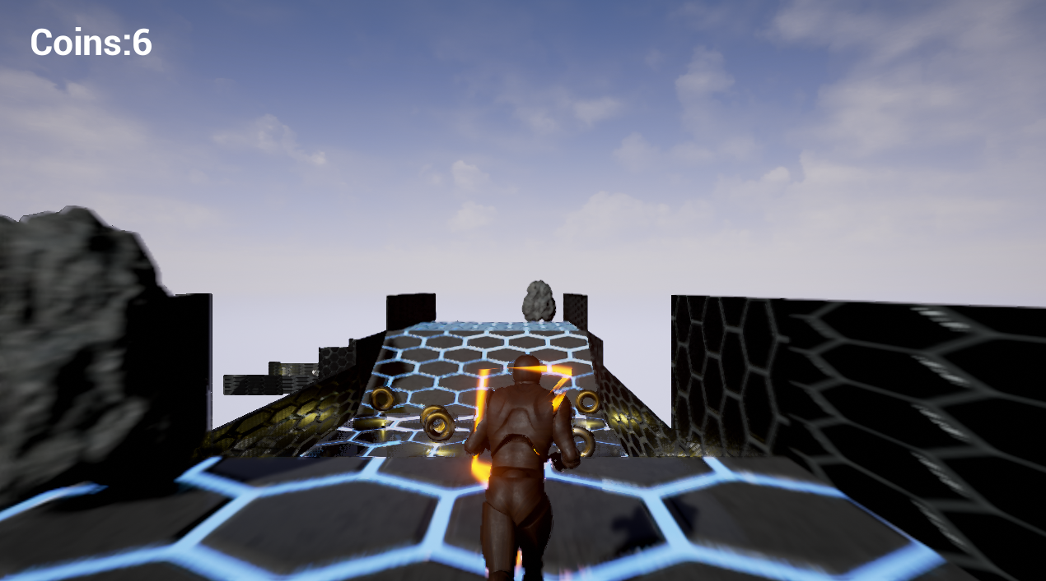
Screenshots

Slide 8
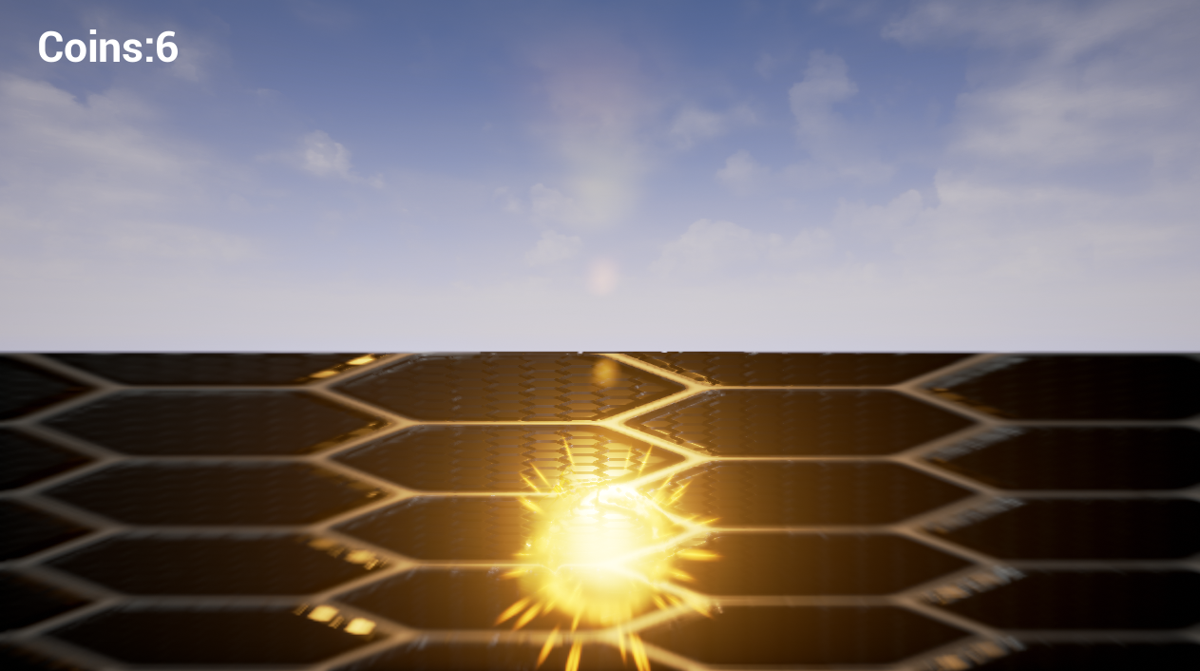
Screenshots

Slide 9
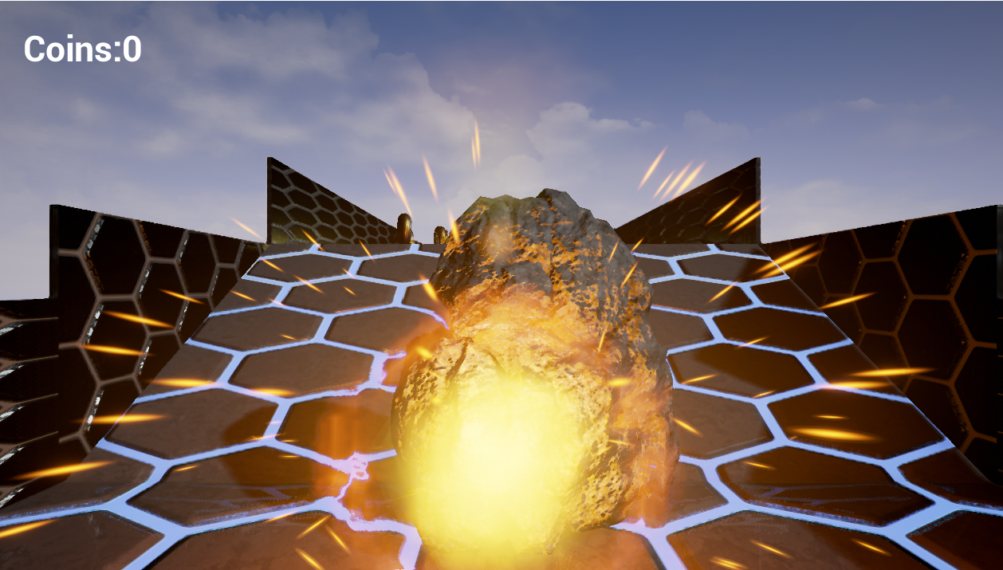
Screenshots

Slide 10
Conclusion
The Flash” is developed in Unreal Engine 4. It fully meets the requirement of the system for which it has to be developed. The project was completed within the given time period. No major problems were encountered and no major risk was involved during development of the project. All the bugs and system error has been removed successfully. The system has reached a steady state. The system operates at a required level of efficiency.

Slide 11
BIBLIOGRAPHY
The materials referred during the pre-development stages of the project include:
https://docs.unrealengine.com/latest/INt/
https://www.youtube.com/user/UnrealDevelopmentKit

Slide 12
Thank You

